Slide 1
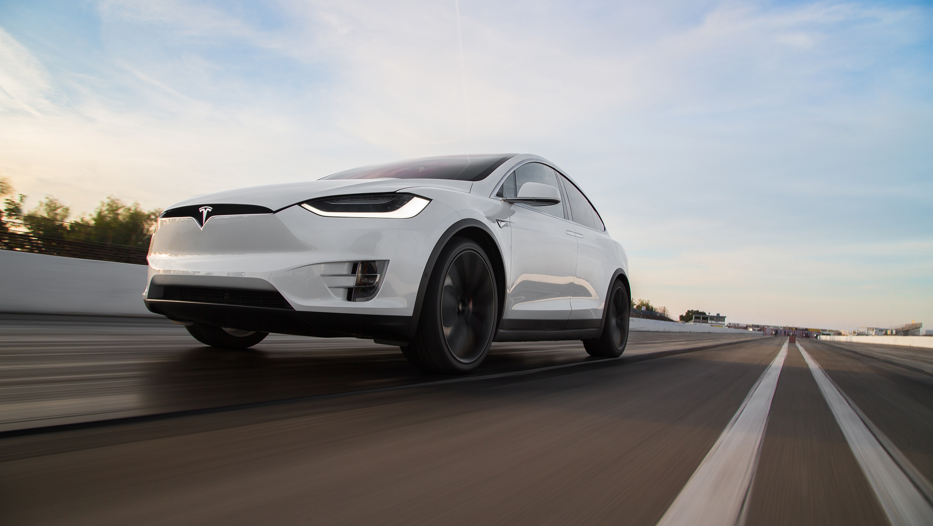
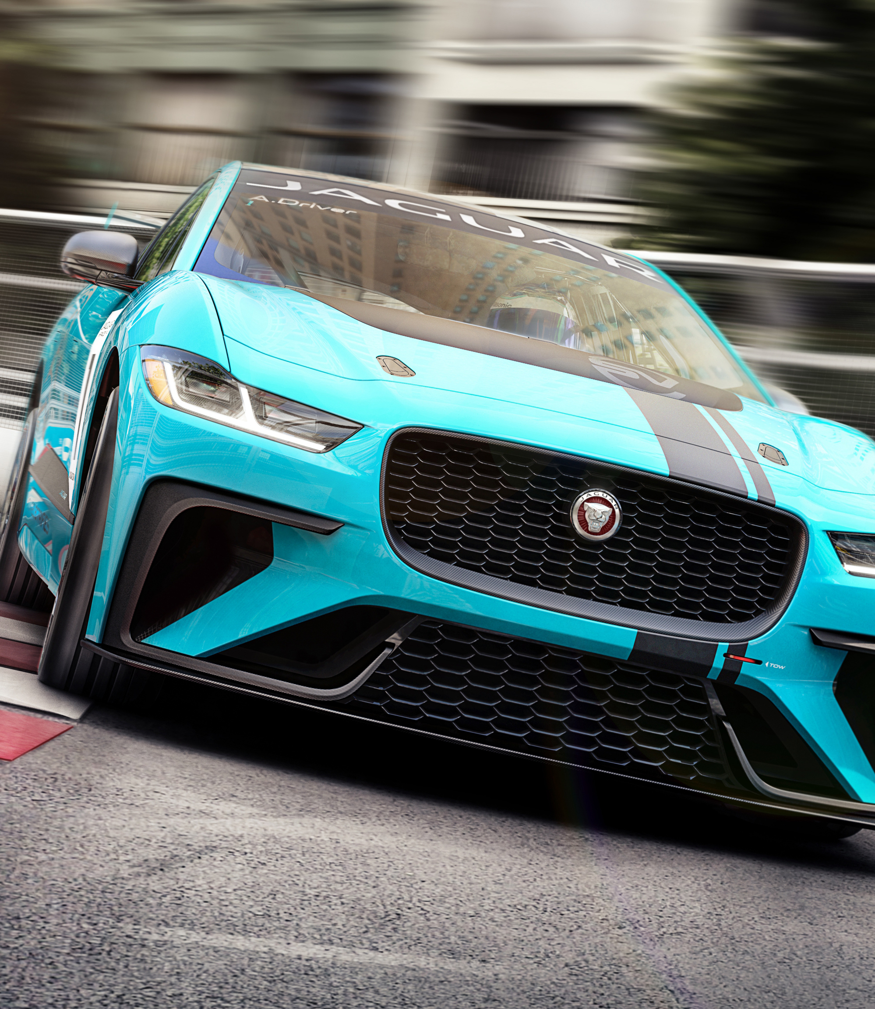
Electric Cars
[2]
[1]
Are they really as efficient as we think?
Notes:
I haven’t talked about enough cars in the last half an hour. So here’s a bit from me about the efficiency of electric cars

Slide 2
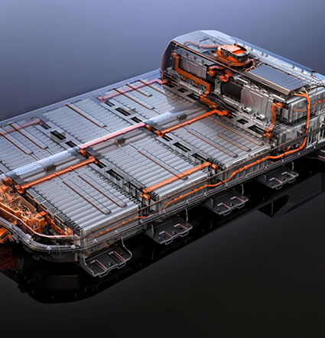
How do Electric Cars work?
[3]
Battery modules (made up of cells)
Tesla Induction motor
Spinning axle
Notes:
Quickly, I am going to go over how an electric car works. An electric car uses modules of battery cells which provide a DC current to a Tesla motor, designed by Nikola Tesla who is considered the father of modern engineering. This motor provides a rotating alternating current so the cars axle can turn the wheels. This battery module is what provides the power for the whole car to run. With less mechanical moving parts and less explosions, electric cars have always seemed to be more efficient. (To learn about internal combustion explosions feel free to attend engineering society)

Slide 3
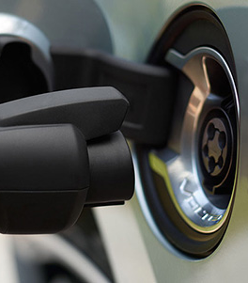
The Issue
[4]
The range of the car
Long charging times
Seen with Jaguar I Pace
Notes:
Many people have a problem with the long wait times for charging the batteries and its low ranges (distance a car can travel while on full battery). People don’t want to be charging their car and so people prefer cars with a larger battery like what Jaguar have done. However, that makes cars more expensive and heavier. It also presents a new problem of materials, which are finite and as with crude oil we cannot afford to use it all. Reports from Quartz, which prompted my research suggested the Jaguar I Pace is really inefficient with its battery usage.

Slide 4


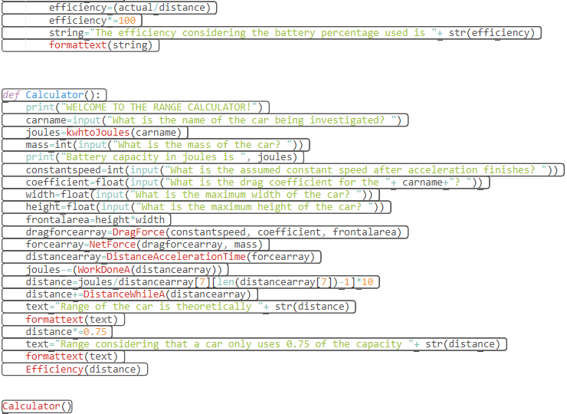
Programming A Calculator
Used to test the efficiency
Assumes 75% of a battery is used as not all the battery can be used
Available here
Notes:
I have programmed a calculator (on Python) to be able to test the efficiency of each car. It was made because the quartz article, which started all of this, does not provide calculations. It assumes 75% of the battery is used as manufacturers program it so it does not damage the battery in the long term. Draining batteries is bad for the battery because it reduces the amount it can be charged back to afterwards.
I have programmed it to provide an estimate which should be good to about ±2% but depends on some of the parameters entered. This also calculates the drag coefficient and includes that in its equations.

Slide 5
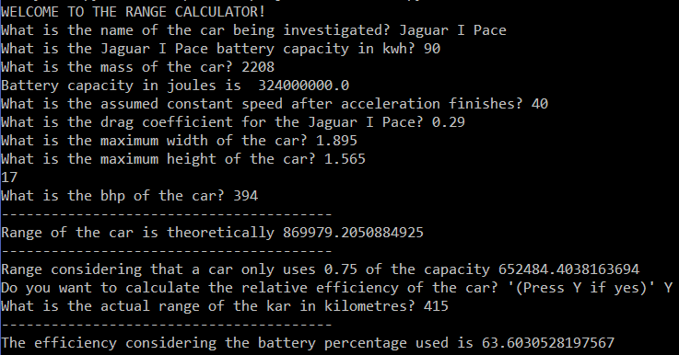
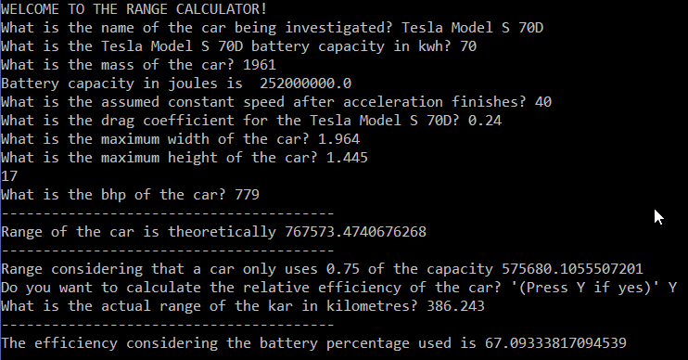
Using the Calculator
Used for Jaguar I Pace and Tesla Model S 70D
Notes:
I used the aforementioned calculator to compare the I Pace and the S 70D as those were what the Quartz article compare. Interestingly they only differed by an efficiency of 4%. The Jaguar I Pace came in at 63% and the Tesla Model S came in at 67%.
This now presents a completely different problem. The Quartz article seems to be missing the point as it seems that all the batteries are inefficient. Explanations of this must be found.
I proceeded with some research and discovered some interesting facts.

Slide 6
Possible Explanations
CAR MANUFACTURES LIE! (Dr Sam Cooper)
Heatspots and other uses of the battery
Notes:
A conversation with Dr Sam Cooper, a fuel cell and battery professor at Imperial, suggested one possible explanation. He suggested to me that the actual ranges when buying a car is actually much higher. However, many drivers do not realise this as they are in a hurry to charge their vehicles whenever they can. A true test would find their ranges are higher and so are closer to being 100% efficient.
He believes that the reasons car manufacturers do this is because as the battery degrades and to avoid legal suits they need to make sure it is appropriate for a set amount of time.
Another reason is possibly the work done that is converted into heat energy. With so many cells, they each provide heat and heat the car. Also some of the energy is used to power other parts of the car such as the dashboard and multiple screens. However, this is made up in regenerative braking.

Slide 7
So what does this actually mean?
[5]
The Answer: Yes!
But exactly how much?
Are there any other formulations ready for the road?
Notes:
For those of you who still haven’t drowned into a sleep its time for me to conclude and explain what I’ve just waffled on about. In reality, it seem that electric cars are actually very efficient, much more than their fuel-guzzling counterparts. However, there is still room in the industry to improve, but current battery research instead seems to be focussed on making them lighter.

Slide 8
Bibliography
Jaguar I Pace e-Trophy. (2017). [image] Available at: http://www.hdcarwallpapers.com/jaguar_i_pace_etrophy_electric_race_car_4k_2-wallpapers.html
Tesla Model X. (n.d.). [image] Available at: http://wallsdesk.com/tesla-model-x/tesla-model-x-4k/ [Accessed 23 Mar. 2019].
plugincars. The Chevy Bolt’s battery warranty covers for eight years and 100,000 miles—and if its capacity drops by 40 percent [Internet]. 2018. Available from: https://www.plugincars.com/what-you-need-know-about-electric-car-battery-warranties-132884.html
go ultra low. Electric charging at home [Internet]. 2015. Available from: https://www.goultralow.com/news/consumer/no-more-trips-to-the-petrol-station/attachment/charging-car-cu-620/
Imgur. What does that mean? [Internet]. 2012. Available from: https://imgur.com/gallery/SLUYm

